Slide 1
PISA for Development
Technical Strand 2: Enhancement of PISA Cognitive Instruments
Ray Adams
John Cresswell
Washington, April 2014
Centre for Global Educational Monitoring

Slide 2
Overview
This presentation will look at the following points and seek discussion from participants:
Current PISA assessment frameworks
Cross cultural validity
An examination of easier items
Test design alternatives
Proficiency levels
Scaling methods
Possible strategies for moving ahead

Slide 3
PISA for Development
Observation 1: In any move to expand the use of PISA to a greater number of countries it would be essential to carry out a complete review of the assessment frameworks in consultation with those countries. It might be expected that the areas currently included for assessment which are seen as priorities by OECD countries may not coincide with the areas that are seen as priorities for developing countries. At the same time any extension of the framework will need to continue to incorporate the original philosophy of PISA.

Slide 4
PISA Assessment Frameworks
An assessment framework is a statement and discussion about what an assessment intends to measure based on an agreed philosophy.
The development of a subject area assessment framework is guided by a group of internationally recognised experts.
In PISA test developers are included in the expert group, or at least attend expert group meetings, so that they gain understanding of the theory underlying the framework.
Frameworks normally start with a definition of the assessable domain, followed by an elaboration of the terms of the domain,

Slide 5
PISA Assessment Frameworks
Countries should, while planning their future analysis and reporting, consider the relevance of the areas described in the assessment frameworks.
Feedback from countries on relevance of different parts of the assessment frameworks will guide those who are composing the tests.
Country involvement in this process will also go towards the capacity-building approaches in this project

Slide 6
PISA Reading Framework
Reading literacy is understanding, using, reflecting on and engaging with written texts, in order to achieve one’s goals, develop one’s knowledge and potential, and participate in society.

Slide 7
PISA Reading Framework
The PISA reading literacy assessment is built on three major task characteristics to ensure a broad coverage of the domain:
situation, which refers to the range of broad contexts or purposes for which reading takes place;
text, which refers to the range of material that is read; and
aspect, which refers to the cognitive approach that determines how readers engage with a text.

Slide 8
PISA Reading Framework
Aspect | Percentage of total points
 | Print | Digital
Access and retrieve | 22 | 19
Integrate and interpret | 54 | 23
Reflect and evaluate | 22 | 19
Complex | 0 | 39
Total | 100 | 100

Slide 9
Factors affecting item difficulty
The difficulty of any reading literacy task depends on an interaction among several variables.
In access and retrieve tasks, difficulty is conditioned by
  the number of pieces of information that the reader needs to locate, by the amount of inference required, by
  the amount and prominence of competing information, and
  the length and complexity of the text.

Slide 10
Factors affecting item difficulty
In integrate and interpret tasks, difficulty is affected by
  the type of interpretation required (for example, making a comparison is easier than finding a contrast);
  the number of pieces of information to be considered;
  the degree and prominence of competing information in the text; and
  the nature of the text: the less familiar and the more abstract the content and the longer and more complex the text, the more difficult the task is likely to be.

Slide 11
Factors affecting item difficulty
In reflect and evaluate tasks, difficulty is affected by
  the type of reflection or evaluation required (from least to most difficult, the types of reflection are: connecting; explaining and comparing; hypothesising and evaluating);
  the nature of the knowledge that the reader needs to bring to the text (a task is more difficult if the reader needs to draw on narrow, specialised knowledge rather than broad and common knowledge);
  the relative abstraction and length of the text; and
  the depth of understanding of the text required to complete the task

Slide 12
Factors affecting item difficulty
In tasks relating to continuous texts, difficulty is influenced:
  by the length of the text, the explicitness and transparency of its structure, how clearly the parts are related to the general theme,
  and whether there are text features, such as paragraphs or headings, and discourse markers, such as sequencing words.

Slide 13
Factors affecting item difficulty
In tasks relating to non-continuous texts, difficulty is influenced
  by the amount of information in the text;
  By the list structure (simple lists are easier to negotiate than more complex lists);
  whether the components are ordered and explicitly organised, for example with labels or special formatting; and
  whether the information required is in the body of the text or in a separate part, such as a footnote.

Slide 14
PISA Science Framework
For the purposes of PISA, scientific literacy refers to an individual’s:
Scientific knowledge and use of that knowledge to identify questions, acquire new knowledge, explain scientific phenomena and draw evidence-based conclusions about science-related issues.
Understanding of the characteristic features of science as a form of human knowledge and enquiry.
Awareness of how science and technology shape our material, intellectual and cultural environments.
Willingness to engage in science-related issues, and with the ideas of science, as a reflective citizen.

Slide 15
PISA Science Framework
The PISA definition of scientific literacy may be characterised as consisting of four interrelated aspects:
Context: recognising life situations involving science and technology.
Knowledge: understanding the natural world on the basis of scientific knowledge that includes both knowledge of the natural world, and knowledge about science itself.
Competencies: demonstrating scientific competencies that include identifying scientific issues, explaining phenomena scientifically, and using scientific evidence.
Attitudes: indicating an interest in science, support for scientific enquiry, and motivation to act responsibly towards, for example, natural resources and environments.

Slide 16
PISA Mathematics Framework
In PISA, mathematical literacy is defined as follows:
Mathematical literacy is an individual’s capacity to formulate, employ, and interpret mathematics in a variety of contexts. It includes reasoning mathematically and using mathematical concepts, procedures, facts and tools to describe, explain and predict phenomena. It assists individuals to recognise the role that mathematics plays in the world and to make the well-founded judgments and decisions needed by constructive, engaged and reflective citizens.

Slide 17
PISA Mathematics Framework
Mathematical literacy can be analysed in terms of three interrelated aspects:
the mathematical processes that describe what individuals do to connect the context of the problem with mathematics and thus solve the problem, and the capabilities that underlie those processes;
the mathematical content that is targeted for use in the assessment items; and
the contexts in which the assessment items are located.

Slide 18
PISA for Development
Observation 2: Extensive consultation and participant involvement in test development activities have been the core of PISA. The extent of consultation with potential developing country participants and their capacity to influence PISA design choices needs to be given careful consideration.

Slide 19
PISA for Development
The normal PISA process includes:
Engagement of professional test development teams from a number of countries
The use of international experts to guide framework and item development
A requirement that all items are trialled by all participating economies
The implementation of extensive linguistic adaptation and verification
Careful psychometric review of all items

Slide 20
PISA for Development
The normal PISA process includes:
Examination of item-by-country interactions in both Field Trial and Main Survey
Extensive framework and item review opportunities by all participants
Submissions of items actively sort from all participants with high priority given to the use of participant submissions

Slide 21
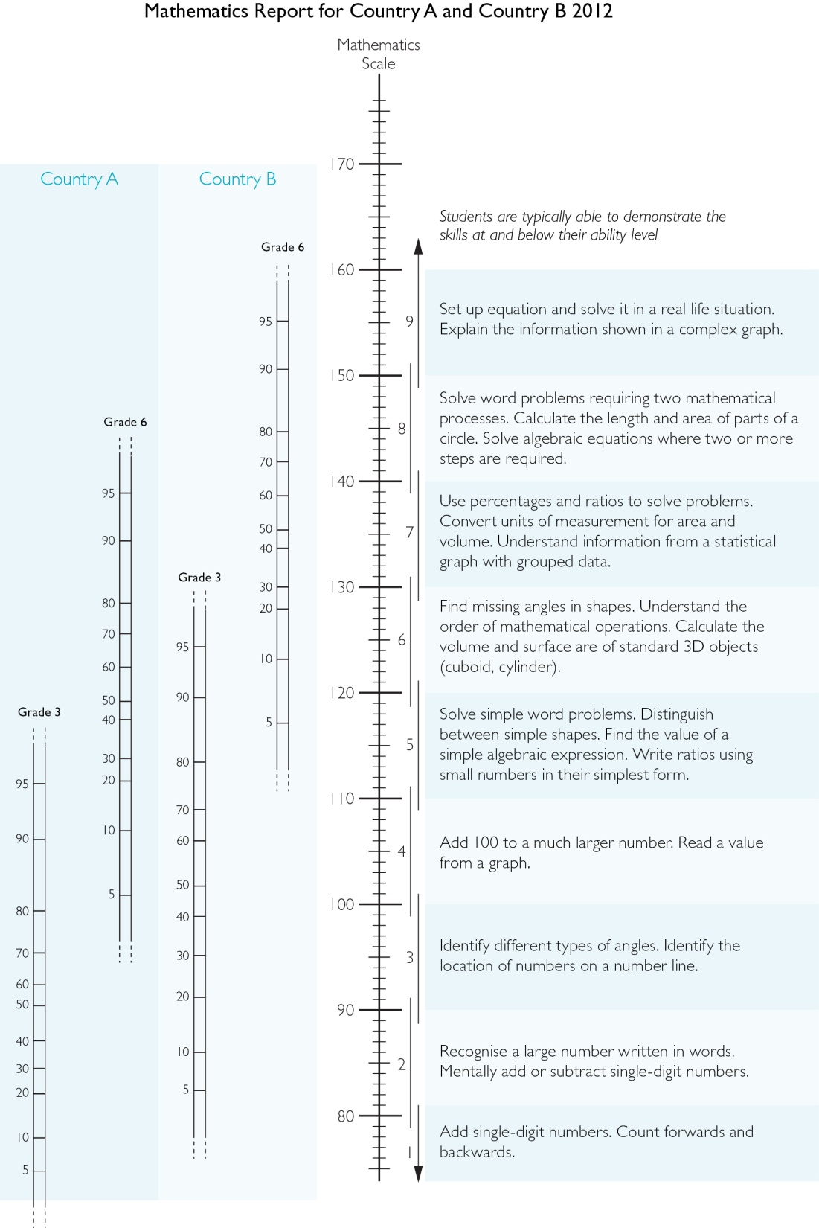

Slide 22
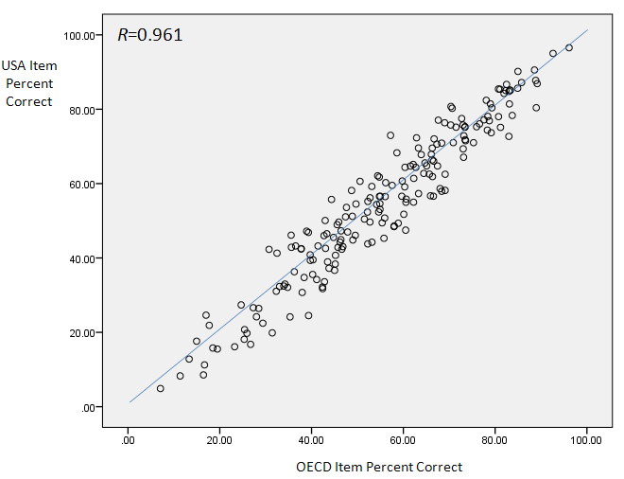
Empirical evidence concerning cross cultural validity

Slide 23
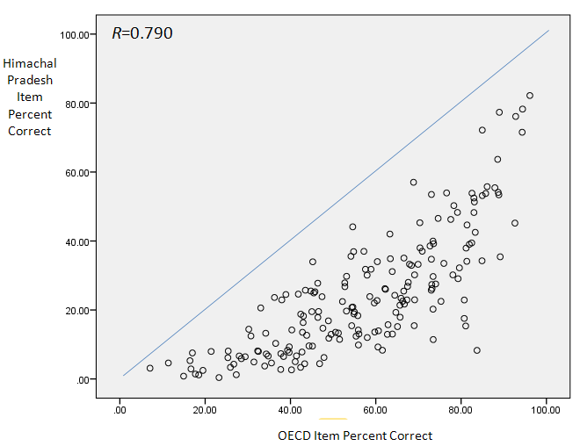
Empirical evidence concerning cross cultural validity

Slide 24
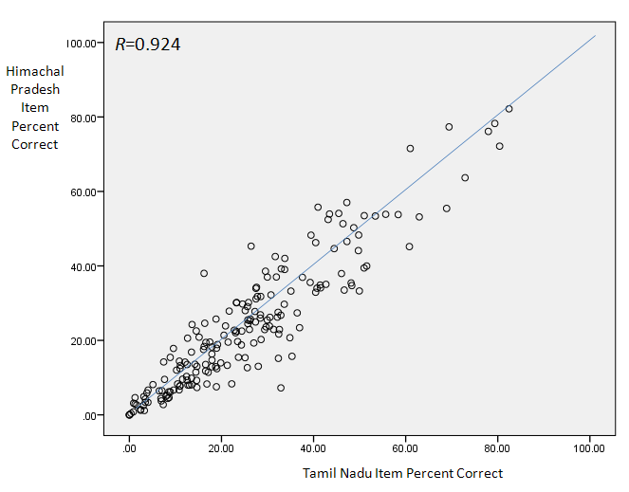
Empirical evidence concerning cross cultural validity

Slide 25
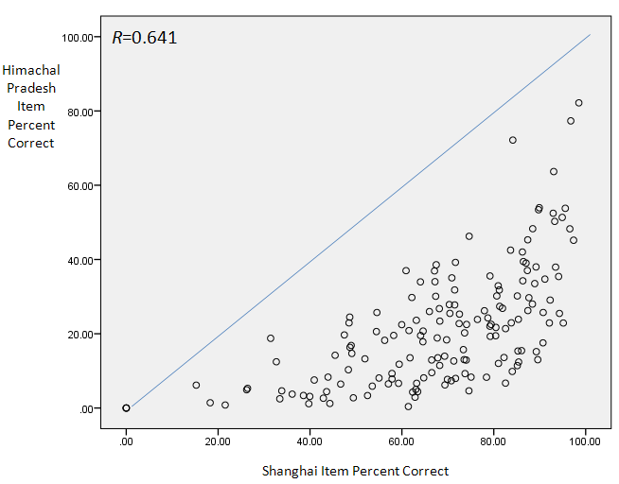
Empirical evidence concerning cross cultural validity

Slide 26
Empirical evidence concerning cross cultural validity
Grisay et al. study is the most systematic look at cross-cultural validity and it highlights two factors as main contributors to uniqueness
  Non indo-european language
  Item difficulty
Supported by the hundreds of DIF reports we have produced over the years

Slide 27
Empirical evidence concerning cross cultural validity
Observation 3: The item-by-country interactions (country DIF) appear to be enormous between developing countries. This has severe implications for the validity of described scales and for construct comparability more generally.

Slide 28
Review of Secure Item Pool
 | Number Of Different Items Used | Number Of Released Items | Number Of Secure Items
Reading | 223 | 80 | 143
Mathematics | 169 | 64 | 105
Science | 125 | 36 | 89
Total | 517 | 180 | 337

Slide 29
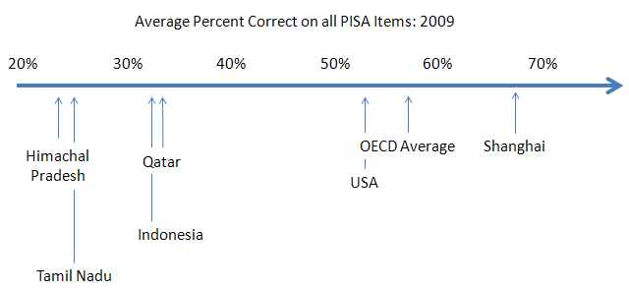
How Difficult are PISA Items?

Slide 30
How Difficult are PISA Items?
Observation 4: The PISA tests are set at quite a high difficulty level, relative to typical student performance. In the case of countries that perform less well the average percent correct on the items is very low and assessing students with such a test is clearly inappropriate.

Slide 31
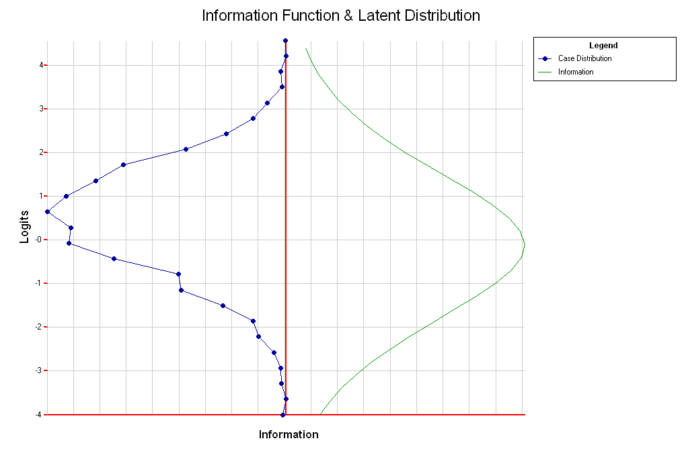
Information Function: Reading

Slide 32
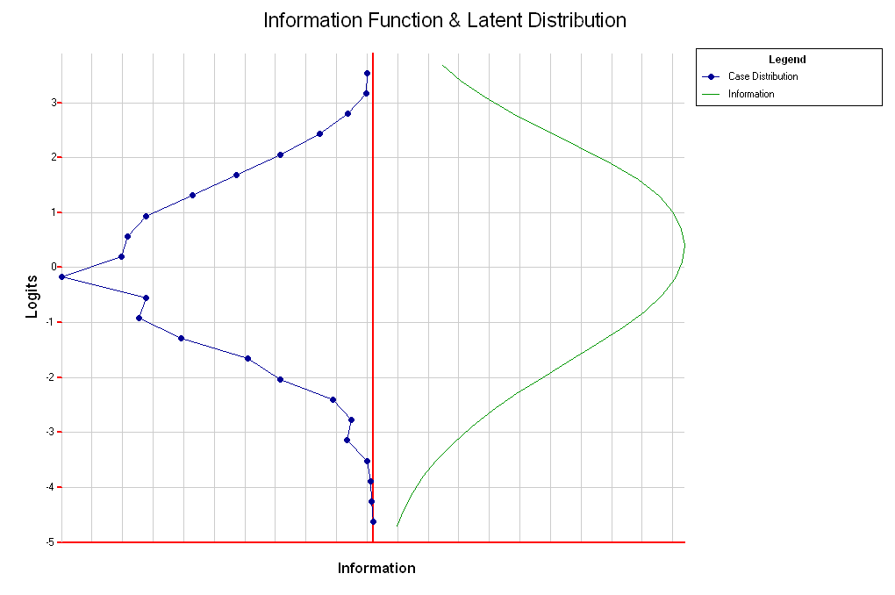
Information Function: Mathematics

Slide 33
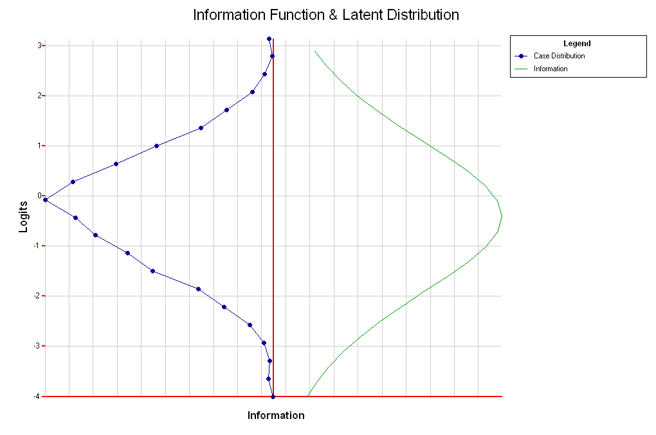
Information Function: Science

Slide 34
Observation 5: The pool of secure PISA items is well targeted in terms of optimising the average measurement precision across all participants

Slide 35
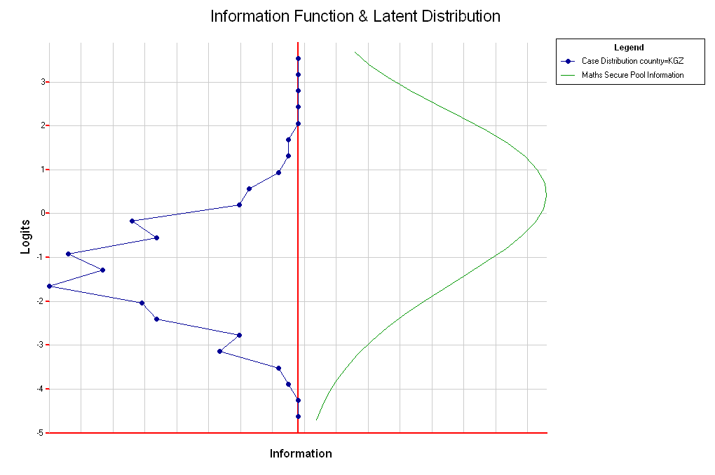
How do things look for poorer performing countries and secure items only?
Example: Mathematics, Kyrgyzstan 2009

Slide 36
How do things look for poorer performing countries and secure items only?
 | Interval
 | Less than ‑2.55 | ‑2.55 to ‑2.12 | ‑2.12 to ‑1.91 | ‑1.91 to ‑1.59 | ‑1.59 to ‑1.27 | 1.27 to ‑1.06 | 1.06 to ‑0.74 | ‑0.74 to ‑0.42 | ‑0.42 to ‑0.11 | Greater than ‑0.11
Proportion of Information | 0.14 | 0.05 | 0.03 | 0.05 | 0.05 | 0.04 | 0.08 | 0.07 | 0.06 | 0.43
Example: Mathematics, Kyrgyzstan 2009

Slide 37
Observation 6: The available secure item pool has an information profile that does not match the likely proficiency profile in candidate PISA for development countries. It follows that utilising a test design that results in administering each of the existing secure items to an equal number of students would not be efficient.

Slide 38
Could an easier (valid) test be constructed from the secure pool?
For the sake of moving forward some assumptions
  Pencil and paper delivery
  A single two-hour booklet
  Unit structure is a major constraint that has been ignored in the following

Slide 39
Easy Secure Reading
 | Number Of Secure Items | Proportion Of Total | Number Of Easy (1) Secure Items | Proportion Of Total For Easy (1) Secure Items | Number Of Easy (2) Secure Items | Proportion Of Total For Easy (2) Secure Items | Target Proportion In Most Recent Framework
Access And Retrieve | 42 | 29 | 19 | 51% | 29 | 40 | 22%
Integrate And Interpret | 71 | 50 | 16 | 43% | 35 | 48 | 56%
Reflect And Evaluate | 30 | 21 | 2 | 5% | 9 | 12 | 22%
Total | 143 |  | 37 |  | 73

Slide 40
Easy Secure Mathematics: Content
 | Number Of Secure Items | Proportion Of Total | Number Of Easy Secure Items | Proportion Of Total For Easy Secure Items | Target Proportion In Most Recent Framework
Change And Relationships | 28 | 27 | 8 | 25% | 25%
Quantity | 24 | 23 | 11 | 35% | 25%
Space And Shape | 28 | 27 | 8 | 25% | 25%
Uncertainty And Data | 25 | 24 | 5 | 16% | 25%
Total | 105 |  | 32

Slide 41
Easy Secure Mathematics: Processes
 | Number Of Secure Items | Proportion Of Total | Number Of Easy Secure Items | Proportion Of Total For Easy Secure Items | Target Proportion In Most Recent Framework
Employ | 49 | 47% | 18 | 56% | 50%
Formulate | 25 | 24% | 3 | 9% | 25%
Interpret | 31 | 30% | 11 | 34% | 25%
Total | 105 |  | 32

Slide 42
Easy Secure Science
 |  | Number Of Secure Items | Proportion Of Total | Number Of Easy Secure Items | Proportion Of Total For Easy Secure Items | Target Proportion In Most Recent Framework
Knowledge Of Science | Earth And Space Systems | 10 | 11% | 6 | 13% | 12%
 | Living Systems | 16 | 18% | 7 | 16% | 16%
 | Physical Systems | 20 | 23% | 12 | 27% | 13%
 | Technology Systems | 8 | 9% | 4 | 9% | 9%
Knowledge About Science | Scientific Enquiry | 16 | 18% | 8 | 18% | 23%
 | Scientific Explanations | 18 | 20% | 8 | 18% | 27%
 | Total | 88 |  | 45

Slide 43
Item Format
 | Reading |  |  | Mathematics |  | Science
 | Number (and %) of Secure Items | Number (and %) of Easy1 Secure Items | Number (and %) of Easy2 Secure Items | Number (and %) of Secure Items | Number (and %) of Easy Secure Items | Number (and %) of Secure Items | Number (and %) of Easy Secure Items
Simple Multiple Choice | 51 (36%) | 21 (57%) | 31 (42%) | 23 (22%) | 7 (22%) | 31 (35%) | 23 (51%)
Auto-Coded Non-Multiple Choice | 12 (8%) | 0 (0%) | 1 (1%) | 28 (27%) | 10 (31%) | 25 (28%) | 14 (31%)
Constructed Response Manual | 28 (20%) | 12 (32%) | 21 (29%) | 24 (23%) | 13 (41%) | 5(6%) | 6 (13%)
Constructed Response Expert | 52 (36%) | 4 (11%) | 20 (27%) | 30 (29%) | 2 (6%) | 27 (31%) | 2 (4%)
Total | 143 | 37 | 73 | 105 | 32 | 88 | 45

Slide 44
Framework Coverage Using Easy Items
Observation 7: Drawing upon easy items only it appears that test designers will face challenges in building a test that matches the framework specifications. The implications in terms of preparing an assessment that is for purpose may not be profound, but it does suggest that it will not be possible to report at the subscale level.

Slide 45
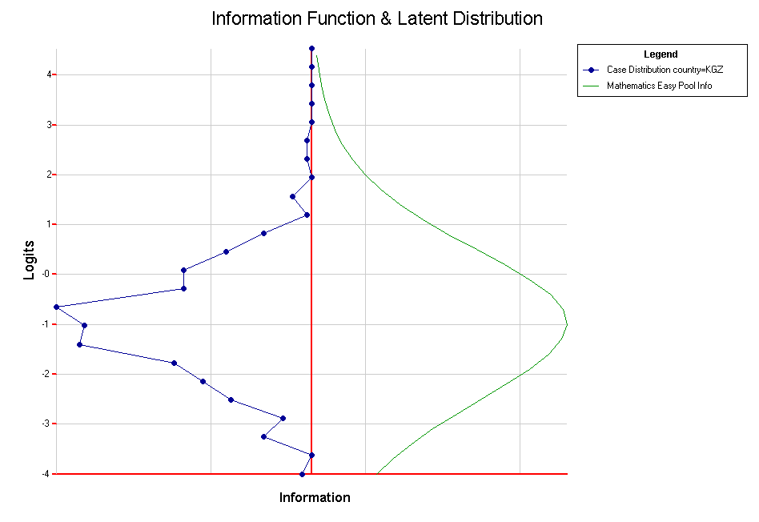
How Easy are the Easy?
Example: Mathematics, Kyrgyzstan 2009

Slide 46
How Easy are the Easy?
 | Interval
 | Less than ‑2.55 | ‑2.55 to ‑2.12 | ‑2.12 to ‑1.91 | ‑1.91 to ‑1.59 | ‑1.59 to ‑1.27 | -1.27 to ‑1.06 | -1.06 to ‑0.74 | ‑0.74 to ‑0.42 | ‑0.42 to ‑0.11 | Greater than ‑0.11
Proportion of Information | 0.21 | 0.08 | 0.04 | 0.07 | 0.07 | 0.06 | 0.06 | 0.08 | 0.06 | 0.27
Example: Mathematics, Kyrgyzstan 2009

Slide 47
Observation 8: If an easy subset of items that approximates the framework is selected from the secure pool it will remain more difficult than is psychometrically ideal for many developing countries - ie, with the smallest possible measurement error In other words the test will be mis-targeted.

Slide 48
PISA 2009 Test Design

Slide 49
Why So Complicated?
Efficiently providing broad coverage
  Sample size
  Individual testing time
Map everything onto a common scale
  Requires “links” (common items)

Slide 50
Observation 9: In contexts where physical and human resources may be limited it will be important to keep the test design as simple as possible. The complicated rotation schemes that have been used in PISA are unlikely to be feasible

Slide 51
A Simpler Design for P4D?
No computer-based testing
Use only “easy” secure material

Slide 52
A Simpler Design for P4D?
Booklet | Cluster 1 | Cluster 2 | Cluster 3 | Cluster 4
One | M₁ | M₂ | S₁ | S₂
Two | S₂ | S₁ | R₁ | R₂
Three | R₂ | R₁ | M₂ | M₁

Slide 53
A Simpler Design for P4D?
This design uses one hour’s worth of testing material for each domain and the booklets are two hours long.
There is no major domain, that is all three assessment domains are equally represented
A non-uniform rotation rate might be advantageous

Slide 54
A Simpler Design for P4D?
Not easy to expand beyond three domains
  eg to include financial literacy, problem solving, global awareness.
The two clusters for each of the domains could perhaps be constructed from the easiest of the secure material to provide reasonable coverage of the frameworks
  Not the sub-scales.

Slide 55
A Simpler Design for P4D?
A shorter booklet, ie less than two hours has not been suggested because of the detrimental impact of such a change on comparability.
For the purposes of out of school testing we would see no difficulty in randomly selecting from one of the above three booklets or with using a separate one-hour booklet similar to the current UH booklet.

Slide 56
Need for Bridging
(linking studies)
New material added
  eg reading components
Units edited
  eg texts shortened or simplified
Test length changed
Probably a good idea anyway because tests easier
  Evidence from easy booklet set from PISA 2009

Slide 57
Proficiency levels
  In PISA student performance is represented in a number of different ways – including, for a country the mean score and the percentage of students in different proficiency levels.
  PISA defines different levels of proficiency to give a description of what students can do. This description is related directly to individual items. The percentage of students in different proficiency levels gives more information than a mean score alone.

Slide 58
6
5
Difficult items
Division of scale into proficiency levels
4
3
2
1
Easier Items

Slide 59
Proficiency levels
  In reading there are now seven proficiency levels – recent PISA cycles have expanded the range of descriptions of student capacity.
  This has been done by including more items at both ends of the scale.

Slide 60
Reading Proficiency levels

Slide 61
Mathematics Proficiency levels

Slide 62
Science Proficiency levels

Slide 63
Proficiency levels
Observation 14, 15: The current PISA described proficiency levels in reading do not provide enough useful information for many developing countries because in some countries, nearly half the students are below the lowest level for which PISA can describe student capacity.

Slide 64
Proficiency levels
Observation 16: When comparing reading, mathematics and science it is the last two which have the largest percentage of students below a described proficiency level - this is partly due to the fact that the described level 1 for reading was extended and divided into two sub-levels.

Slide 65
Proficiency levels
Countries are more likely to participate if they receive information about the vast majority of their students.
Extending the range of proficiency levels to include descriptions of lower ability students will flow from the inclusion of easier items.

Slide 66
Why Scale -- 1
Summarising data
  Allows description of developing competence
    Construct validation
  Dealing with many items
    rotated test forms
  check how reasonable it is to summarise data (through sums, or weighted sums)

Slide 67
What do we want to achieve in our measurement?
Locate students on a line of developing proficiency that describe what they know and can do.
================================
So, we need to make sure that
Our measures are accurate (reliability);
Our measures are indeed tapping into the skills we set out to measure (validity);
Our measures are “invariant” even if different tests are used.

Slide 68
Properties of an Ideal Approach
Scores we obtained are meaningful.
Ann
Bill
Cath
  What can each of these students do?
Scores are independent of the sample of items used
  If a different set of items are used, we will get the same results.

Slide 69
Using Raw Scores?
Can raw scores provide the properties of an ideal measurement?
Distances between differences in scores are not easily interpretable.
Difficult to link item scores to person scores.

Slide 70
Equating raw scores - 2
100%
A
A
Score on the hard test
C
C
B
B
B
C
A
0
100%
Score on the easy test

Slide 71
Link Raw Scores on Items and Persons
Task Difficulties
Object Scores
word problems
25%
?
90%
arithmetic with vulgar fractions
?
50%
70%
multi-step arithmetic
70%
?
50%
single digit addition
?
90%
25%

Slide 72
Item Response Theory (IRT)
Item response theory helps us address the shortcomings of raw scores
  If item response data fit and IRT (Rasch) model, measurement is at its most powerful level.
    Person abilities and item difficulties are calibrated on the same scale.
    Meanings can be constructed to describe scores
    Student scores are independent of the particular set of items in the test.
  IRT provides tools to assess the extent to which good measurement properties are achieved.

Slide 73
IRT
IRT models give the probability of success of a person on items.
IRT models are not deterministic, but probablistic.
Given the item difficulty and person ability, one can compute the probability of success for each person on each item.

Slide 74
Building a Model
Probability of Success
1.0
0.5
0.0
Very low achievement
Very high achievement

Slide 75
Imagine a middle difficulty task
Probability of Success
1.0
☺
😐
0.5
☹
0.0
Very low achievement
Very high achievement

Slide 76
Item Characteristic Curve
Probability of Success
1.0
☺
😐
0.5
☹
0.0
Very low achievement
Very high achievement

Slide 77
Item Difficulty -- 1
δ

Slide 78
Variation in item difficulty
δ₃
δ₁
δ₂

Slide 79
Variation in item difficulty

Slide 80
Estimating Student Ability

Slide 81
Estimating Student Ability

Slide 82
Estimating Student Ability

Slide 83
Estimating Student Ability

Slide 84
Estimating Student Ability

Slide 85
3 | |
| |
X| |
X| |
XX| |
2 XX| |9 22
XXX| |
XXX| |6 16
XXXXX| |8 11 27 29
1 XXXXX| |
XXXXXXX|* |31
XXXXXXX|* |2 30
XXXXXXXXX|* * * |13
XXXXXXXXXX|* * * * * |19
0 XXXXXXX|* * * * * * |5 32
XXXXXXXX|* * * * * |7 15 28
XXXXXXX|* |4 14 21
XXXXXXXX|* * |3 17 20 23
XXXXXXXXX| |10 18 24
-1 XXXXXX| |
XXXX|* |1
XXXX| |
XX| |12 26
-2 XXX| |25
XX| |
X| |
X| |
X| |
-3 X| |

Slide 86
3 | |
| |
X| |
X| |
XX| |
2 XX| |9 22
XXX| |
XXX| |6 16
XXXXX| |8 11 27 29
1 XXXXX| |
XXXXXXX|* |31
XXXXXXX|* |2 30
XXXXXXXXX|* * * |13
XXXXXXXXXX|* * * * * |19
0 XXXXXXX|* * * * * * |5 32
XXXXXXXX|* * * * * |7 15 28
XXXXXXX|* |4 14 21
XXXXXXXX|* * |3 17 20 23
XXXXXXXXX| |10 18 24
-1 XXXXXX| |
XXXX|* |1
XXXX| |
XX| |12 26
-2 XXX| |25
XX| |
X| |
X| |
X| |
-3 X| |
Tasks at level 5 require doing mathematics in an active way: finding suitable strategies, selecting information, posing problems, constructing explanations and so on.
Tasks at level 3 require doing mathematics in a somewhat "passive way", such as manipulating expressions, carrying out computations, verifying propositions, etc, when the modelling has been done, the strategies given, the propositions stated, or the needed information is explicit.
Tasks at level 1 require mainly recall of knowledge, with little interpretation or reasoning.

Slide 87
3 | |
| |
X| |
X| |
XX| |
2 XX| |9 22
XXX| |
XXX| |6 16
XXXXX| |8 11 27 29
1 XXXXX| |
XXXXXXX|* |31
XXXXXXX|* |2 30
XXXXXXXXX|* * * |13
XXXXXXXXXX|* * * * * |19
0 XXXXXXX|* * * * * * |5 32
XXXXXXXX|* * * * * |7 15 28
XXXXXXX|* |4 14 21
XXXXXXXX|* * |3 17 20 23
XXXXXXXXX| |10 18 24
-1 XXXXXX| |
XXXX|* |1
XXXX| |
XX| |12 26
-2 XXX| |25
XX| |
X| |
X| |
X| |
-3 X| |
Why a Rasch Model?
Distance between the location of items and students fully describe students’ chances of success on the item
This property permits the use of described scales

Slide 88
Scaling Models: Item Response Theory
The Rasch model, in its general form was chosen for PISA for a number of reasons:
  Differential item functioning – countries and other groups
  It supports the construction and validation of meaningful described proficiency scales.
  coder effects and item position (booklet) effects.

Slide 89
Scaling Models: Item Response Theory
  Multidimensional scaling.
  Equating tests for the purposes of maintaining and monitoring the validity of trends.
  Integrates with complex sampling designs
  Integrates with multilevel modelling
  Incorporating impact of measurement uncertainty in inference

Slide 90
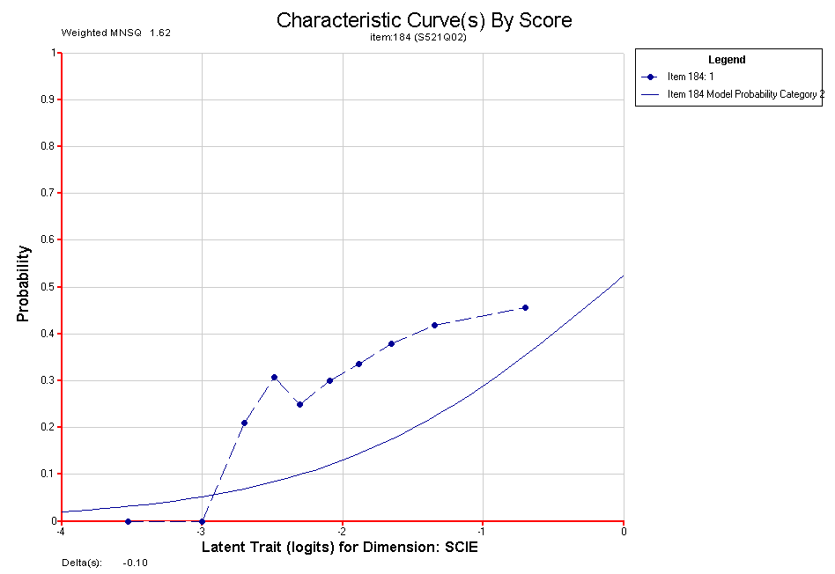

Slide 91
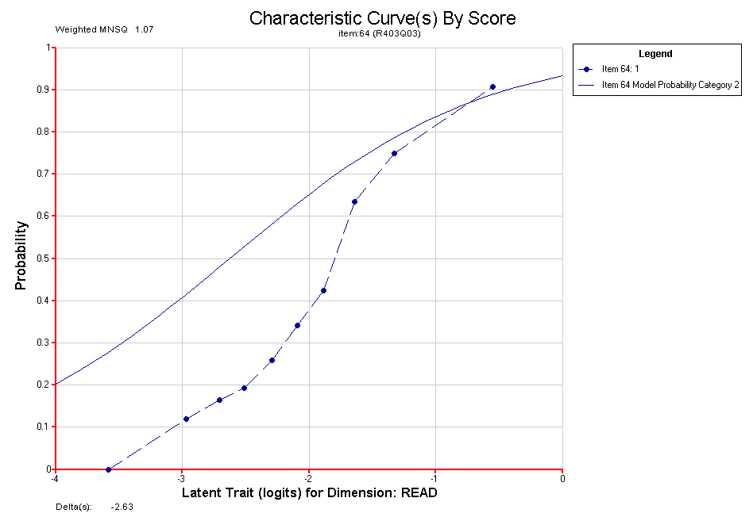

Slide 92
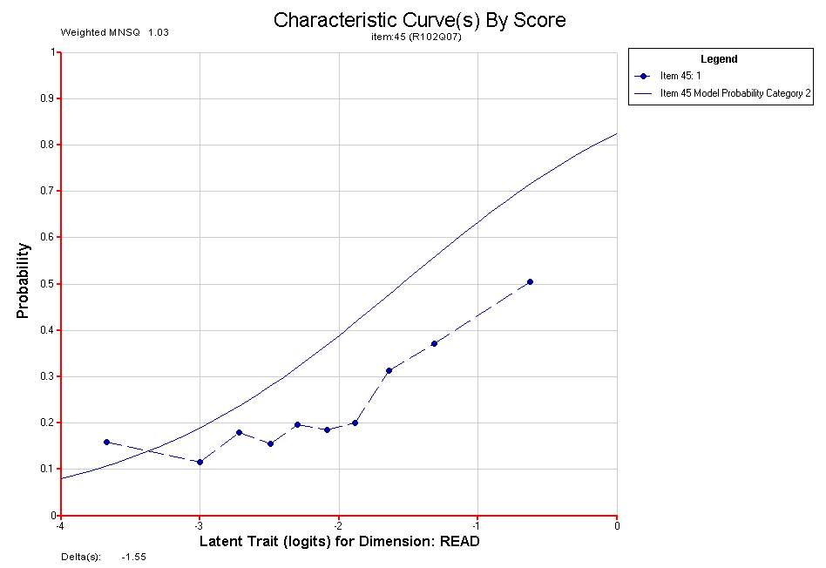

Slide 93
Are Alternatives Possible?
No evidence yet that more general IRT models will fit better or change substantive interpretation
  2PL
  3PL
  Item bundles
Alternatives to IRT
  Latent class
  “basket of goods” approach

Slide 94
The Scaling Problem
No such thing as a zero egg omelette
The only way to compare across countries (or link to a common scale) is to have something that you can assume is stable across contexts.

Slide 95
Observation 18: The use of learning metrics to describe dimensions of educational progression is at the core of the PISA reporting methodology. This approach to reporting and construct validation requires a consistency across countries in item behaviour than is not apparent for PISA items in developing countries

Slide 96
Issues
Assessment frameworks and items
Test design
Proficiency levels
Scaling models

Slide 97
Why participate in P4D
Results which more precisely describe levels of proficiency within country (especially at the lower end) and leads to better analysis.
Learn and build capacity in implementation of PISA (large-scale international student assessment).
Join international community focused on improving learning outcomes based on benchmarking from PISA results.
OECD facilitating national reports based on countries’ policy priorities.

Slide 98
Principles of participation
Countries participating in P4D require an assessment that:
  Reports results on the PISA scale and evidence supports comparability to international PISA results
  Allows students to demonstrate the full range of proficiency levels.
  Adheres to all PISA standards.
  an asseNo such thing as a zero egg omelette
The only way to compare across countries (or link to a common scale) is to have something that you cam assume is stable across contexts.

Slide 99
PISA Technical Standards
Tests will be designed and implemented in accordance with PISA Technical Standards. These refer to issues such as:
  Language of test.
  Population definition and coverage.
  Translation procedures.
  Adaptations.
  Standardised test administration
  Quality assurance including site visits.

Slide 100
Design Principles/Options
Item selection options
  Countries choose items based on local relevance, cultural validity, framework coverage OR
  As above but prioritise test targeting to expected performance OR
  Build test which optimises placement of students on the international PISA scale
  Test design complexity is not an issue
  Threat of cross-cultural validity needs to be assessed and quantified.

Slide 101
Things that maybe we haven’t convinced you of … yet
Student performance at higher levels can be inferred from performance at lower levels.
There’s no such thing as a single PISA test.
A targeted test at the lower levels is not a second-class PISA.
The principle that student assessment should be targeted to meet students where they are now rather than where you want them to be.
Threat of cross-cultural validity needs to be assessed and quantified.

